Slide 1

A guide to UNIPROT - from the UNIPROT resources
Amitava Roy
Bioinformatics and Computational Biosciences Branch
Office of Cyber Infrastructure and Computational Biology
6 April 2021

Slide 2
Today’s Instructor
Amitava Roy, PhD
Computational Structural Biology Specialist
Bioinformatics and Computational Biosciences Branch (BCBB), NIAID
National Institutes of Health, Bethesda, MD USA
Contact our team:
Email: bioinformatics@niaid.nih.gov
Instructor: amitava.roy@nih.gov

Slide 3
UNIPROT
Search for proteins
How to get the most from a basic search
Functional data in a protein entry
Explore specific functions, locations and structural data
Protein sequences and sequence features
Accessing protein sequences
Amino acid modifications
Proteomes
What proteomes are and how to access them
Mutations and disease annotations
Proteins implicated in disease
https://nih.box.com/s/5j37jyrhzwnzdwahmiz4m4nqtqtgo4dk
Files needed
Uniprot_06_April_2021.pptx

Slide 4

UNIPROT
UniProt (Universal Protein Resource): A comprehensive, high-quality and freely accessible resource of protein sequence and functional information
Primary sequences including sequences of isoforms and disease
variants
Physiological protein function including subcellular location,
involvement in pathways and reactions, interactions
Structural information including topology, access to 3D structures
Data analysis tools such as BLAST and multiple alignment
help@uniprot.org

Slide 5



www.uniprot.org
Data source in UniProt:
95% of the protein sequences come from the International Nucleotide Sequence Consortium
Sequence data is also imported from databases such as Ensembl and PDB, and researchers may directly submit sequences to UniProt
Analyse/re- analyse the data
Use/organise
the data
Compare/integrate with other data sets
help@uniprot.org

Slide 6
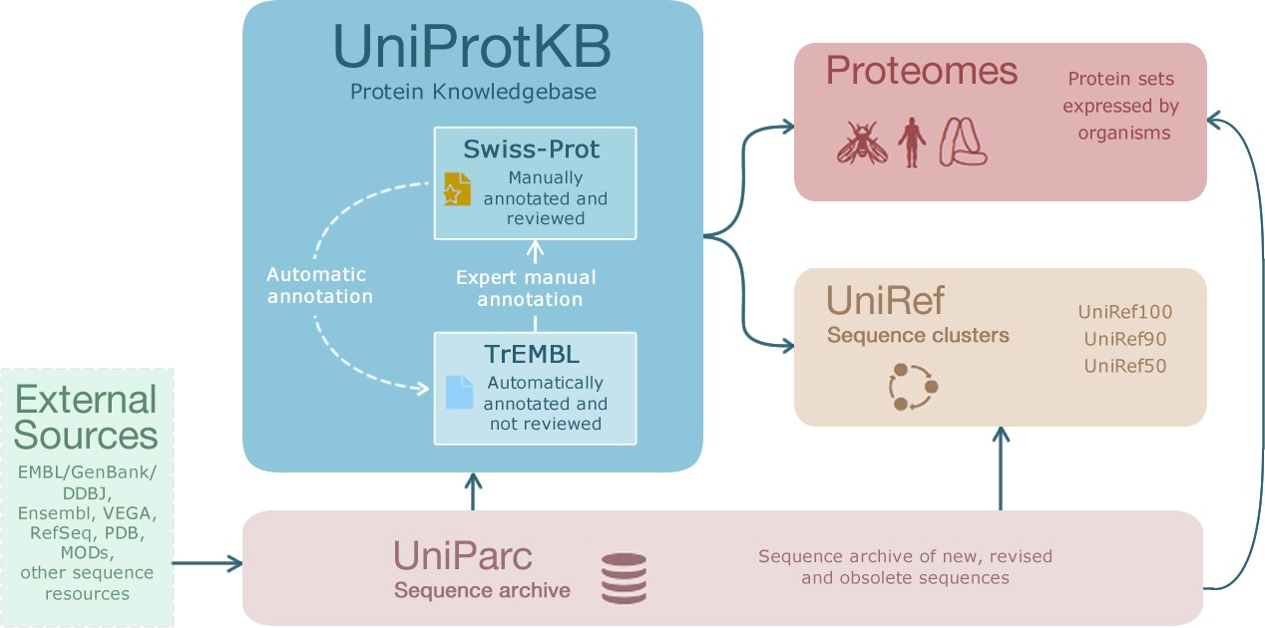
www.uniprot.org
Sequence data are organised into resources

Slide 7
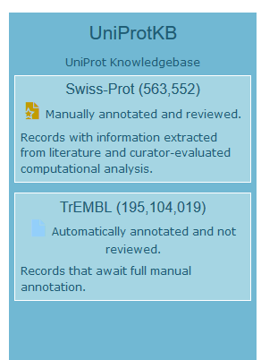
www.uniprot.org
The two datasets in UniProtKB
curated by experts
data from scientific papers
annotation of sequence features
collates isoforms in one entry
annotation from rule systems (incl. expert-curated rules)
mapped experimental sequence features (3D structures)
isoforms are kept separate

Slide 8
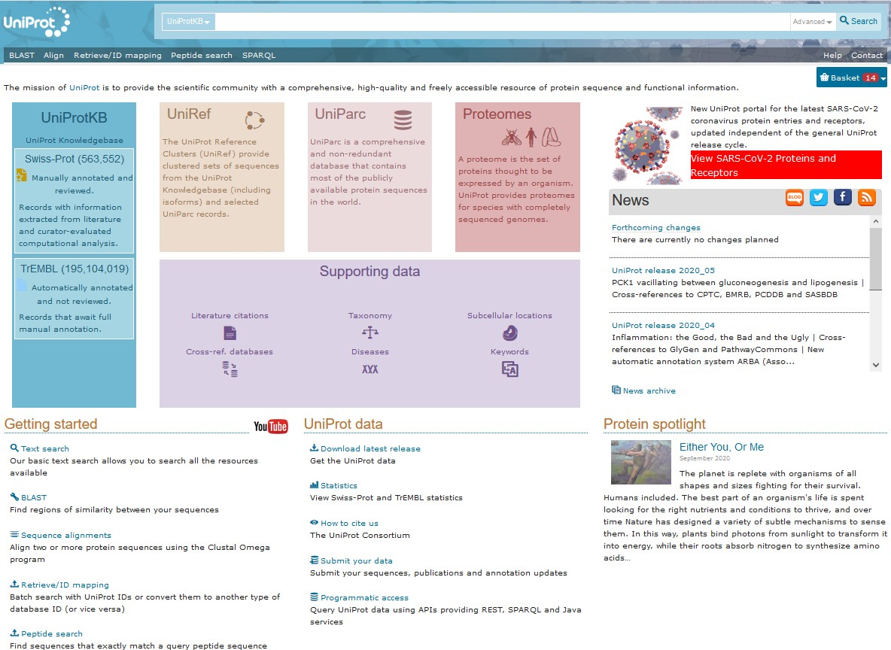
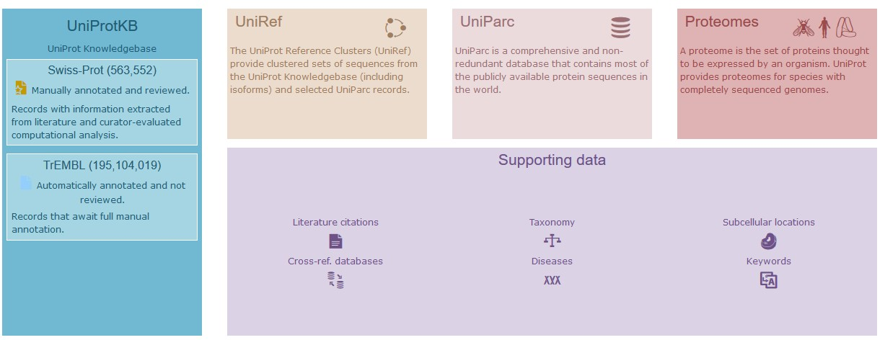
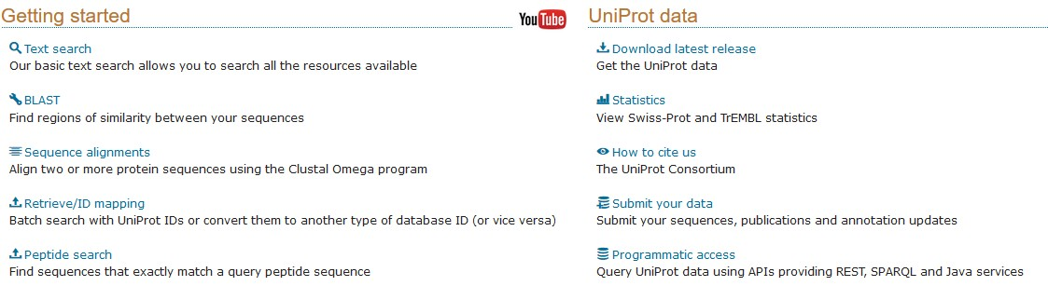
www.uniprot.org
Programmatic access
help@uniprot.org

Slide 9
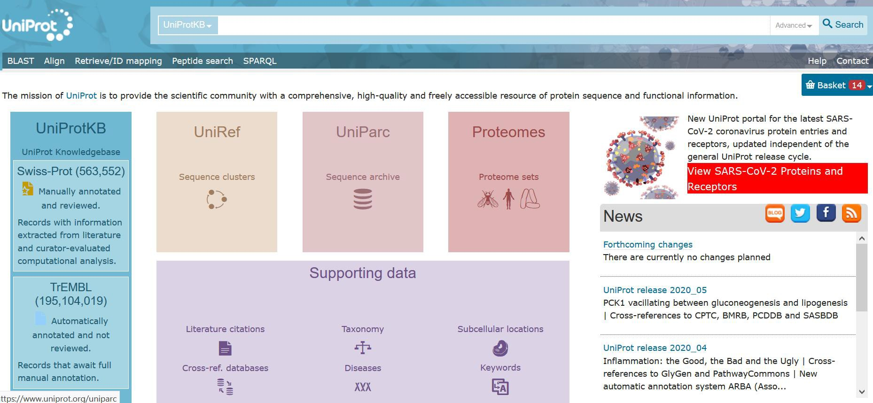
www.uniprot.org
Protein name
Gene ontology terms
Disease
Gene name
10/15/2020

Slide 10
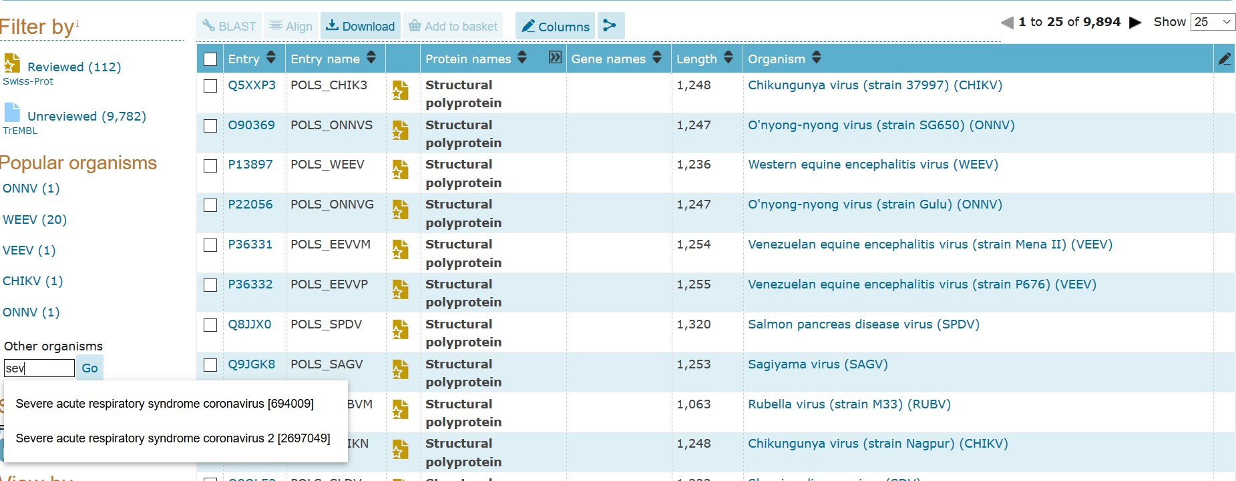
www.uniprot.org
Results page table: Lists protein entries
Apply additional filters to organise your results

Slide 11

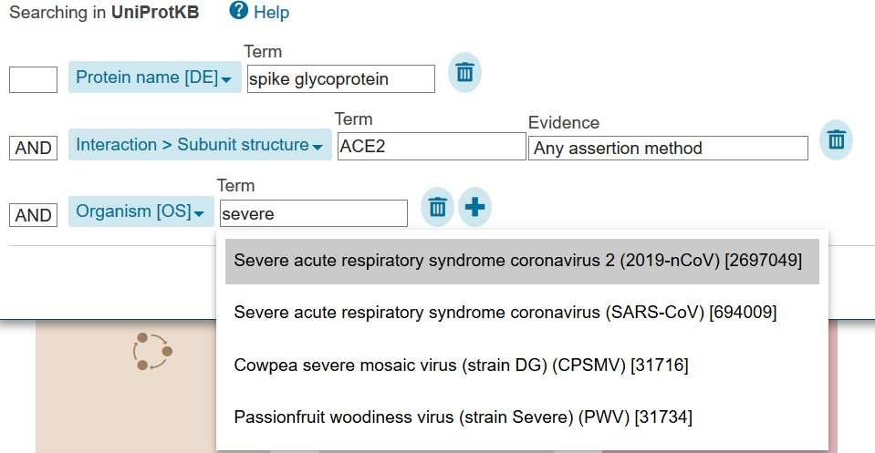
www.uniprot.org
Use the "Advanced" search option to build complex and precise search queries
10/15/2020

Slide 12
www.uniprot.org
Example 1: Using UniProt to study components of biological processes and pathways
ATG16
ATG12
ATG12
ATG12
ATG16
ATG5
ATG5
ATG5
Search for the gene names individually using the UniProtKB free text search bar
Use the advanced search to search by organism

Slide 13
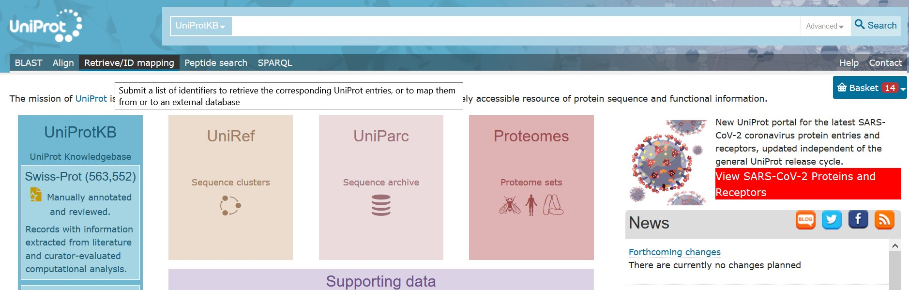
www.uniprot.org
Use the "Retrieve/ID mapping" tool to find multiple proteins at once
10/15/2020

Slide 14
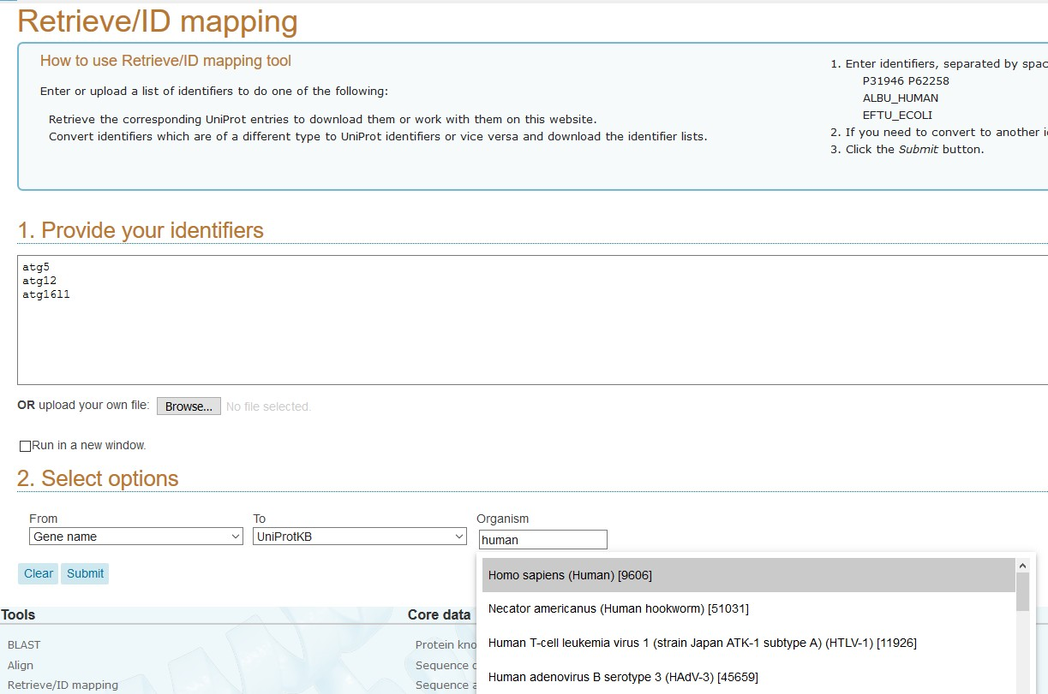
www.uniprot.org
Use the retrieve tool to search for multiple entries at a time
List your gene names
Select your parameters

Slide 15
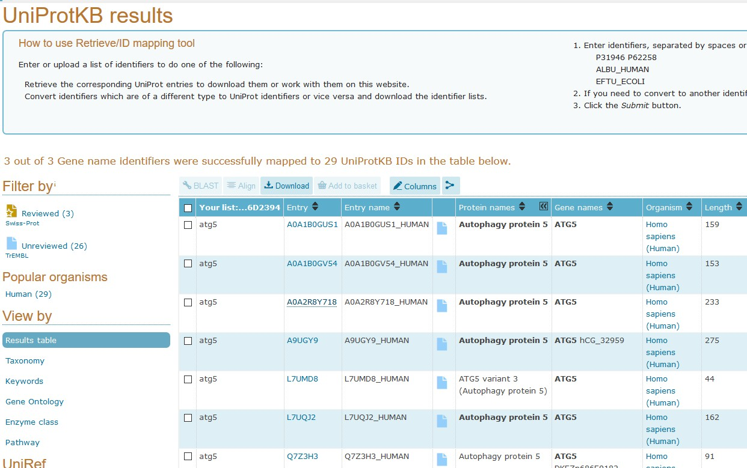
www.uniprot.org
Protein entries corresponding to the gene names are listed
29 entries match the 3 gene names
3 entries are curator reviewed 26 entries have not been reviewed by a curator

Slide 16
www.uniprot.org
Q676U5
O94817
O94817
O94817
Q9H1Y0
Q9H1Y0
Q676U5
Q9H1Y0
Search UniProt using identifiers
Find corresponding genes and protein entries

Slide 17
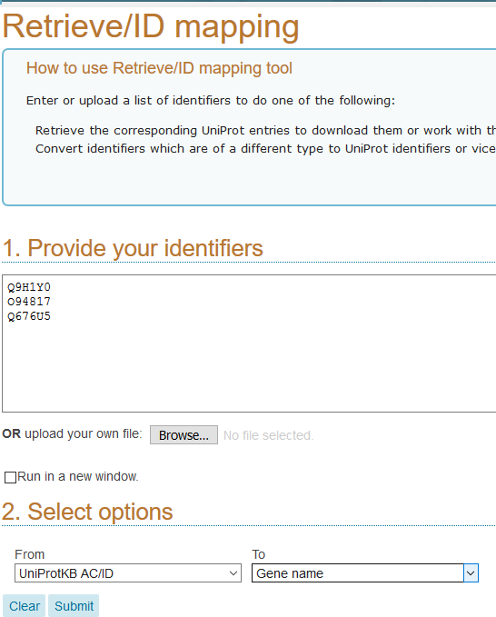
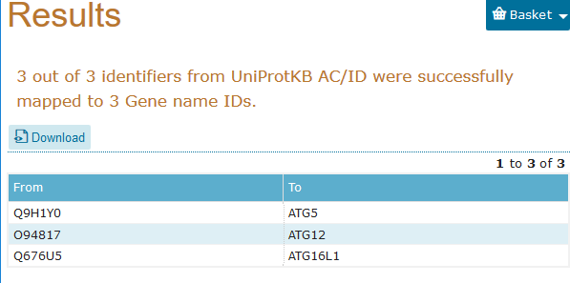
www.uniprot.org
Use the ID mapping tool to convert UniProt identifiers (accession numbers) to gene names
Convert non-UniProt identifiers to UniProt accession numbers and vice versa

Slide 18
www.uniprot.org
Use Peptide search tool on the main homepage to find entries containing a specific sequence
?
=
MALRLLRRAARGAAAAALLRLKASLAADIPRLGYSSSSHH

Slide 19
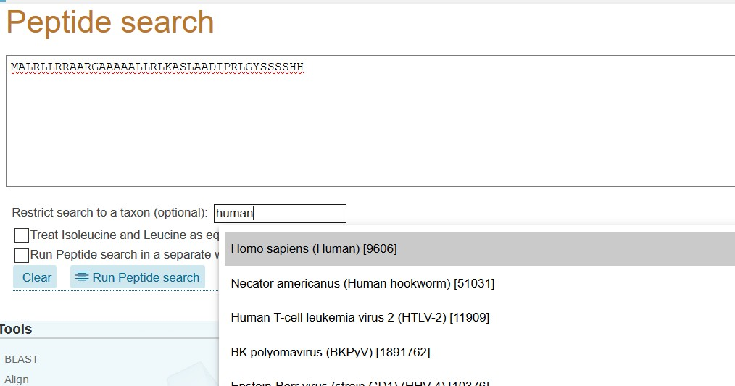
www.uniprot.org
Use the Peptide search tool to search for entries containing a specific string of amino acids
Enter peptide
sequence
Specify the organism

Slide 20
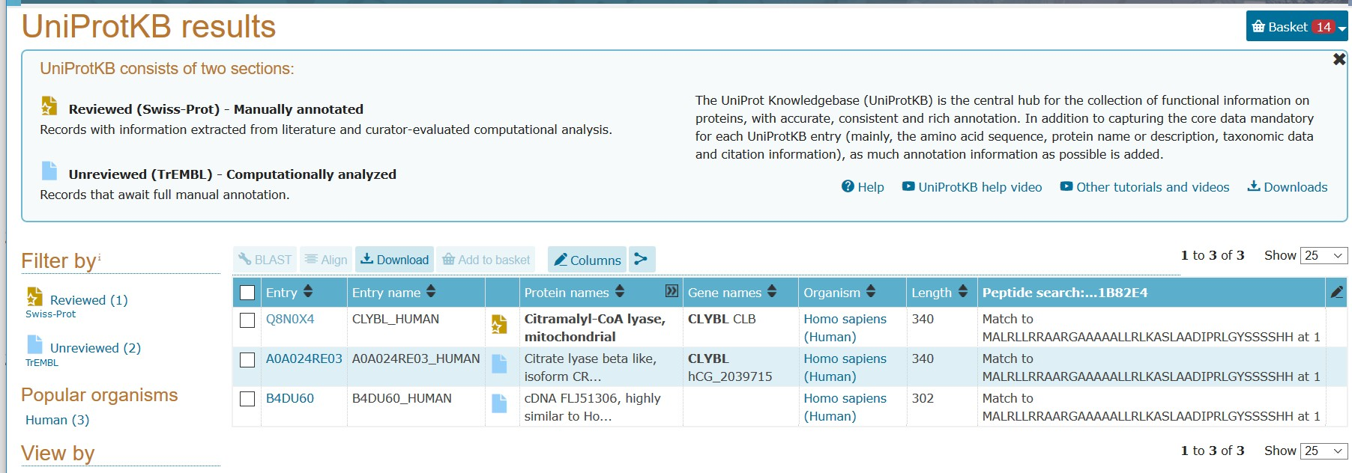
www.uniprot.org
3 protein entries contain this specific string of amino acids
1 entry is curator reviewed 2 entries have not been reviewed by a curator

Slide 21
www.uniprot.org
Example 2: Accessing functional data
Click on the unique accession number to explore an entry

Slide 22
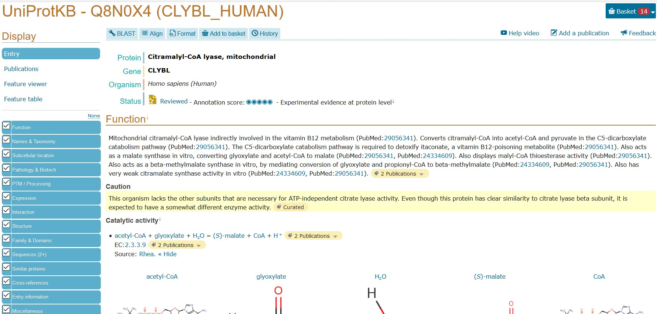
www.uniprot.org
Using left hand menu choose how to view the entry
Click on any of the quick access tabs to explore specific sections of the entry

Slide 23
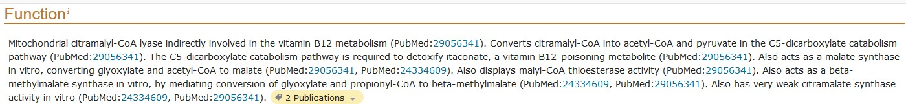
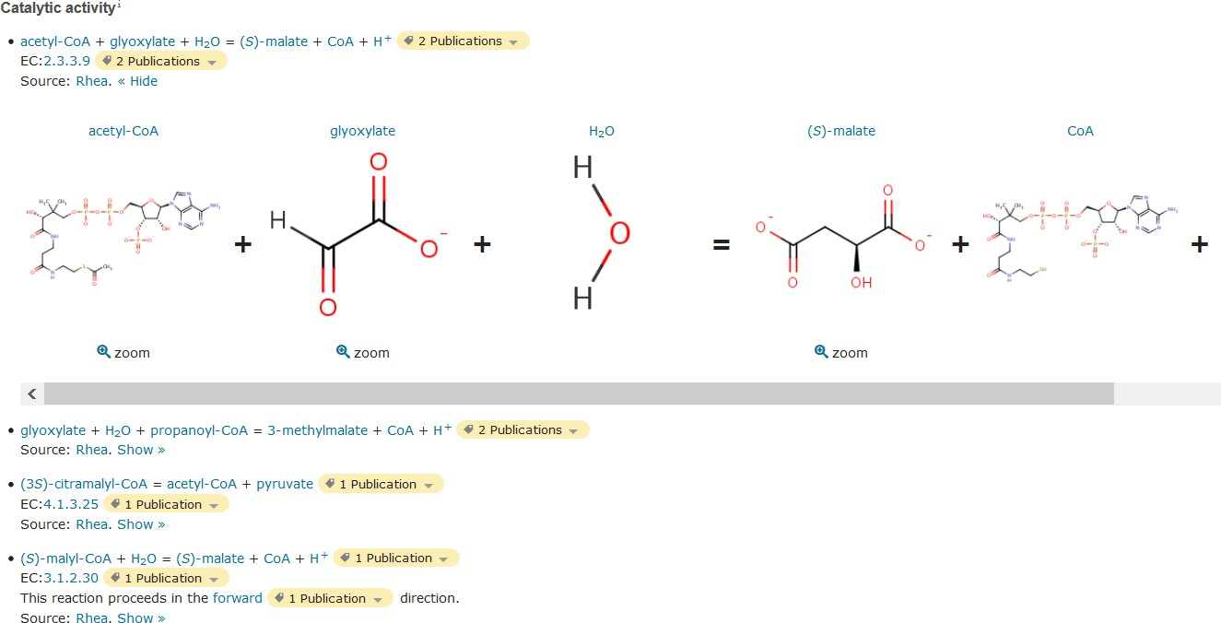
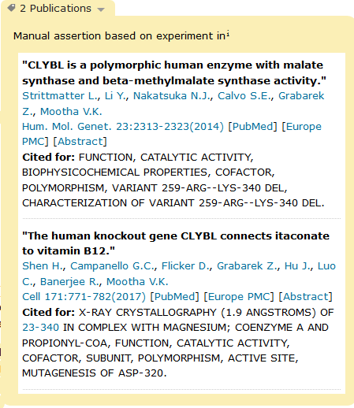
www.uniprot.org
If the protein is an enzyme, view:
The reactions it catalyses and their EC (enzyme commission) number
The publications that cite
this data
Click on reaction participants for molecule details in UniProtKB, Rhea and ChEBI
Drop-down tabs at the end of sections cite the data source

Slide 24
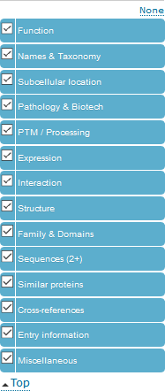
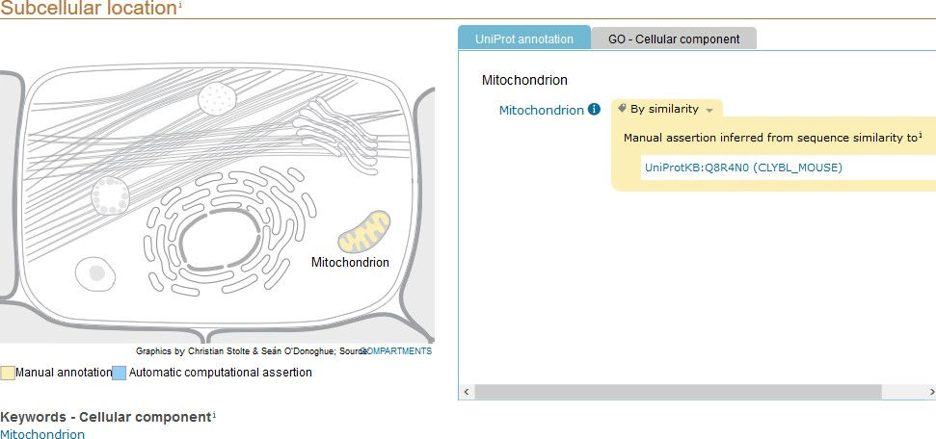
www.uniprot.org
The subcellular location viewer highlights
where the protein is expressed in the cell
In this example, the evidence for the subcellular location is based on orthology and the accession number for the ortholog is provided.

Slide 25
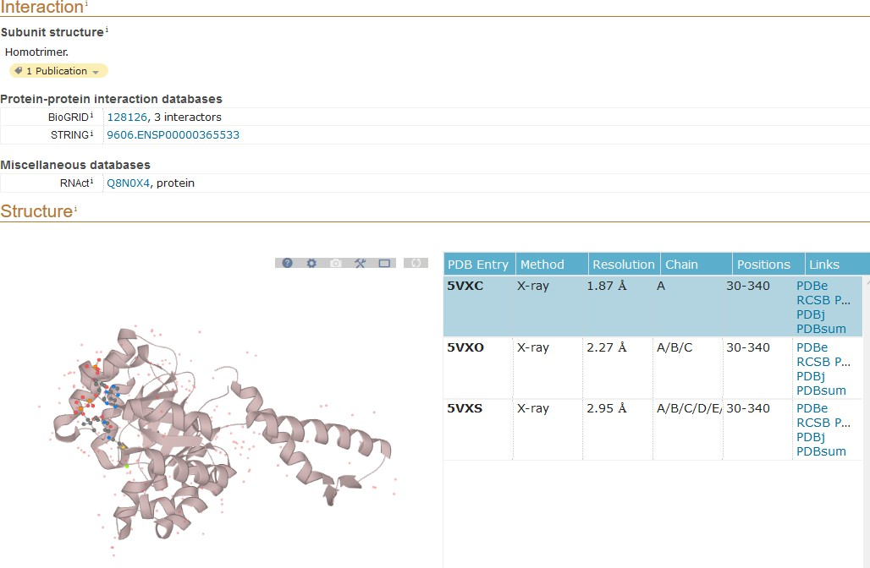
www.uniprot.org
Cross-references to specific databases that provide additional specialist data
Interactive list of 3D structures with direct links to PDB resources

Slide 26
www.uniprot.org
Example 3: Using UniProt to explore protein sequences and sequence features
Protein sequences are available for every protein entry
Isoforms, variants, polymorphisms, sequence errors,
processing information (eg. cleavage sites)
Sequence analysis tools
BLAST
Align

Slide 27
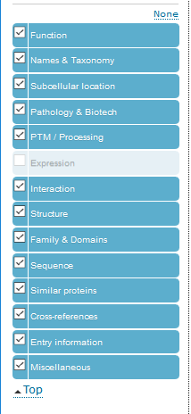
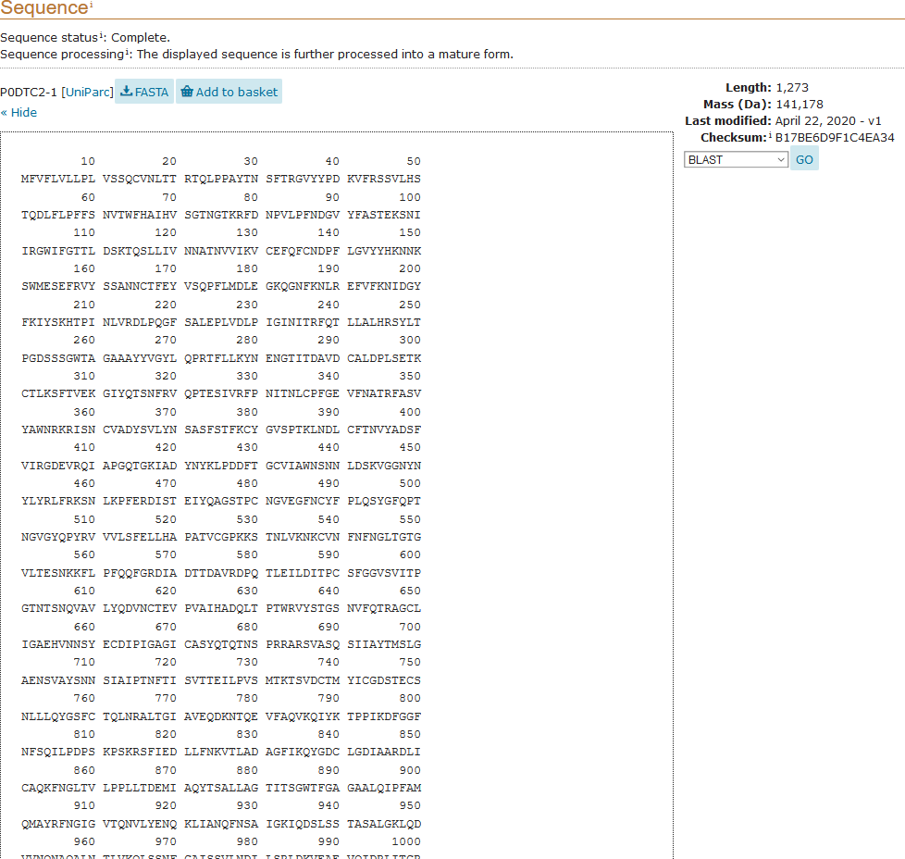
www.uniprot.org
Download fasta

Slide 28
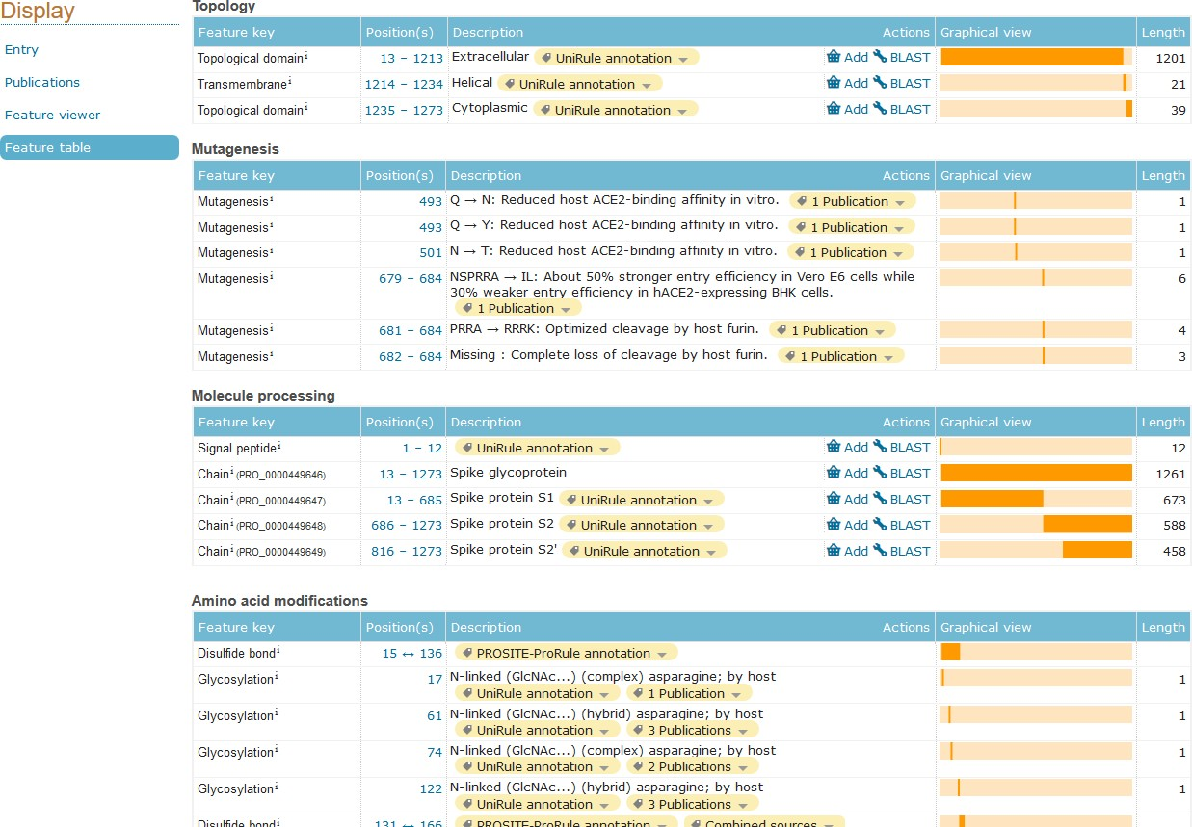
www.uniprot.org
Click on the feature table to view all sequence features, including domain information and amino acid modifications in one table

Slide 29
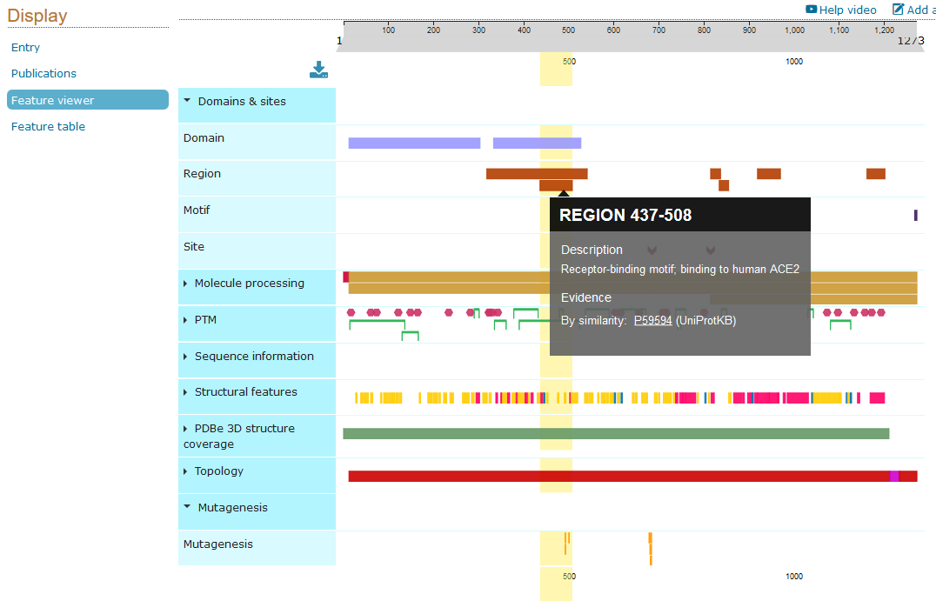
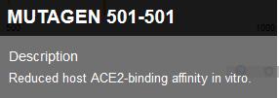
www.uniprot.org
Use the feature viewer to look at features in the context of each other

Slide 30
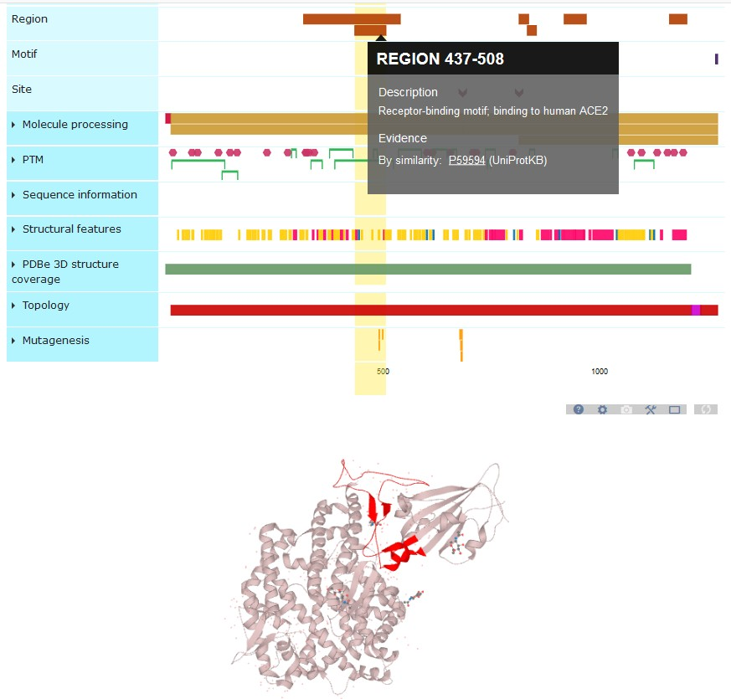
www.uniprot.org
If 3D structures are available, highlight regions of interest in the structure

Slide 31
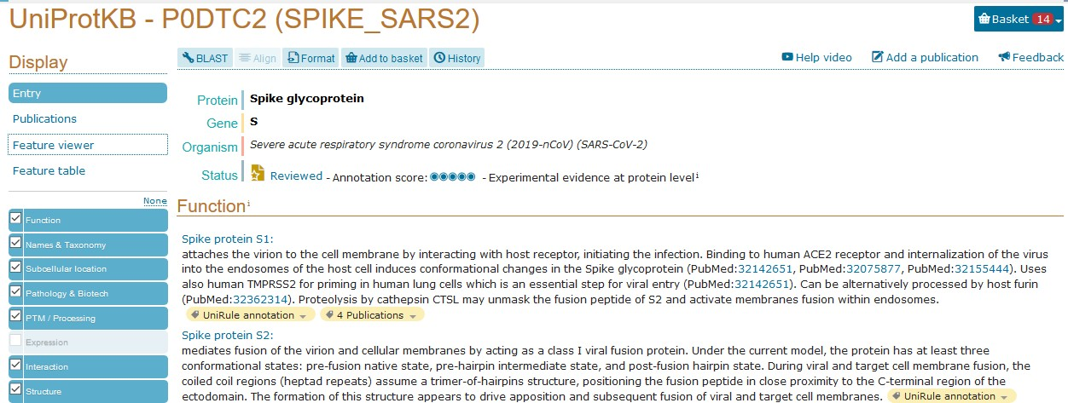
www.uniprot.org
Use BLAST to find similar proteins

Slide 32
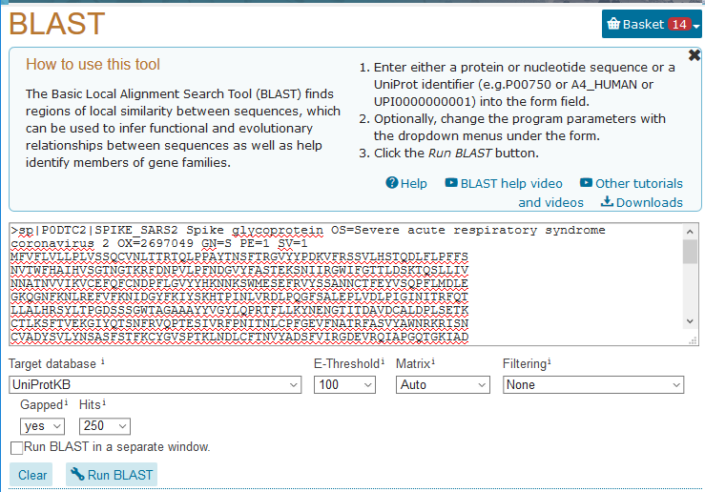
www.uniprot.org
Search for similar sequences using the BLAST tool.
You can search for full- length protein sequences or small sections of protein sequence

Slide 33
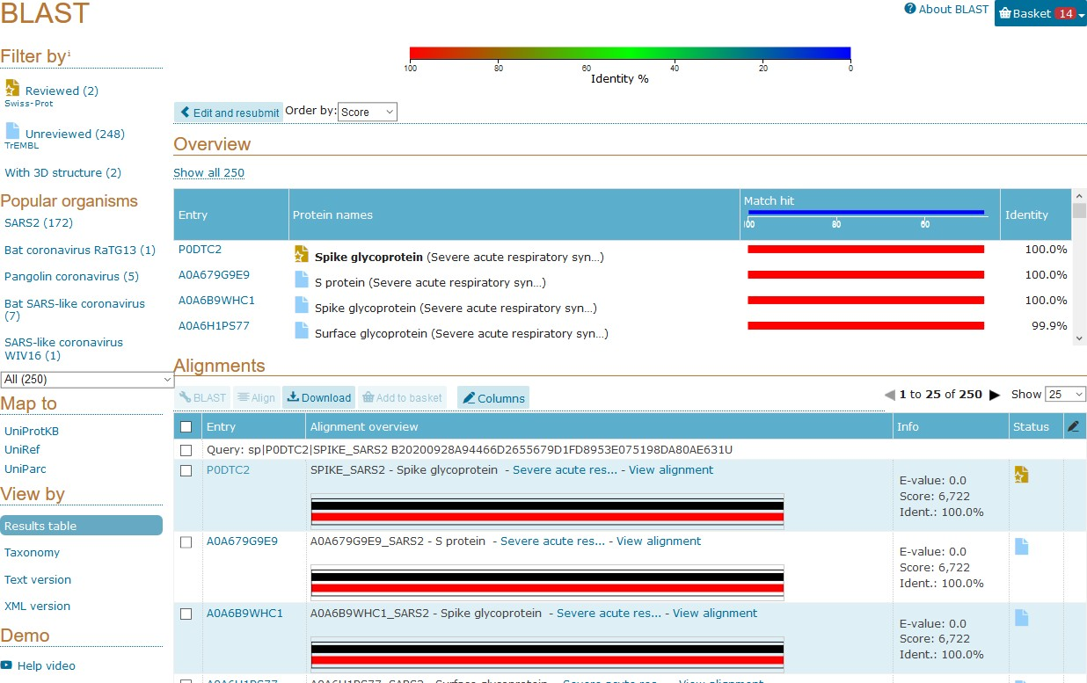
www.uniprot.org
The identity column shows how similar your search query is to individual BLAST hits in the results table

Slide 34
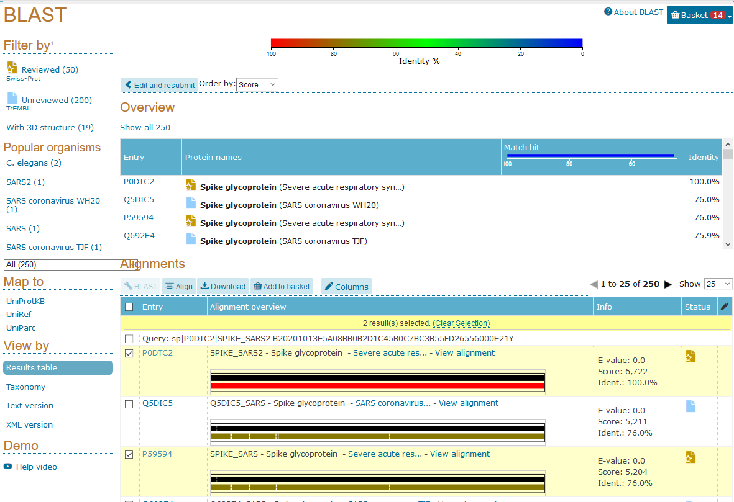

www.uniprot.org
Align Tool
Align 2 or more sequences:
Identify similar regions
Find fully conserved regions/amino acid residues
Indicate functional, structural and evolutionary relationships
URL of Align results are saved for 7 days

Slide 35
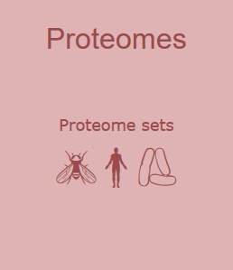
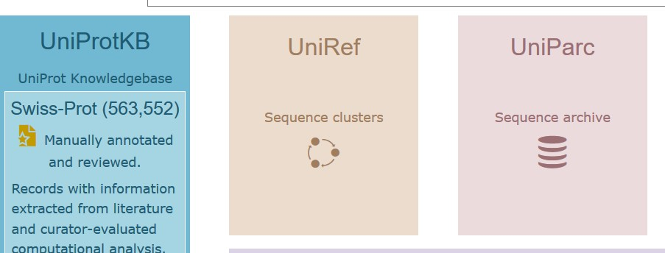
www.uniprot.org
Example 4: Accessing proteomes
Proteomes can be accessed via the main UniProt homepage

Slide 36
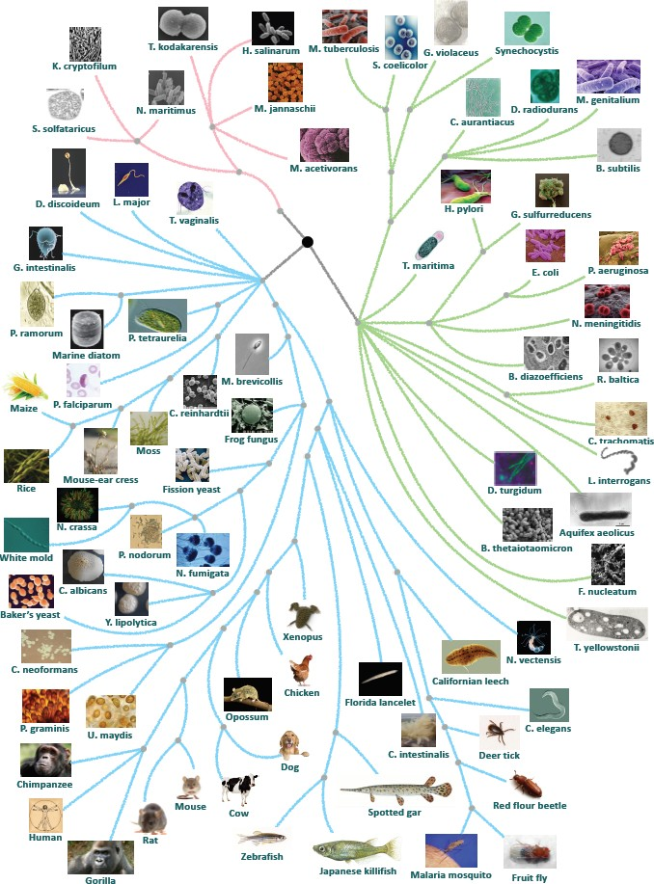
www.uniprot.org
Uniprot has over 160,000 proteomes representing species belonging
to the four super kingdoms Eukaryota, Bacteria, Archaea and Virus.
A proteome contains a set of proteins thought to be expressed by an organism.
Proteomes for species with completely sequenced genomes
Unique identifiers (e.g.
UP000002518)
Protein sequence and functional information for a large variety of species.
10/15/2020

Slide 37
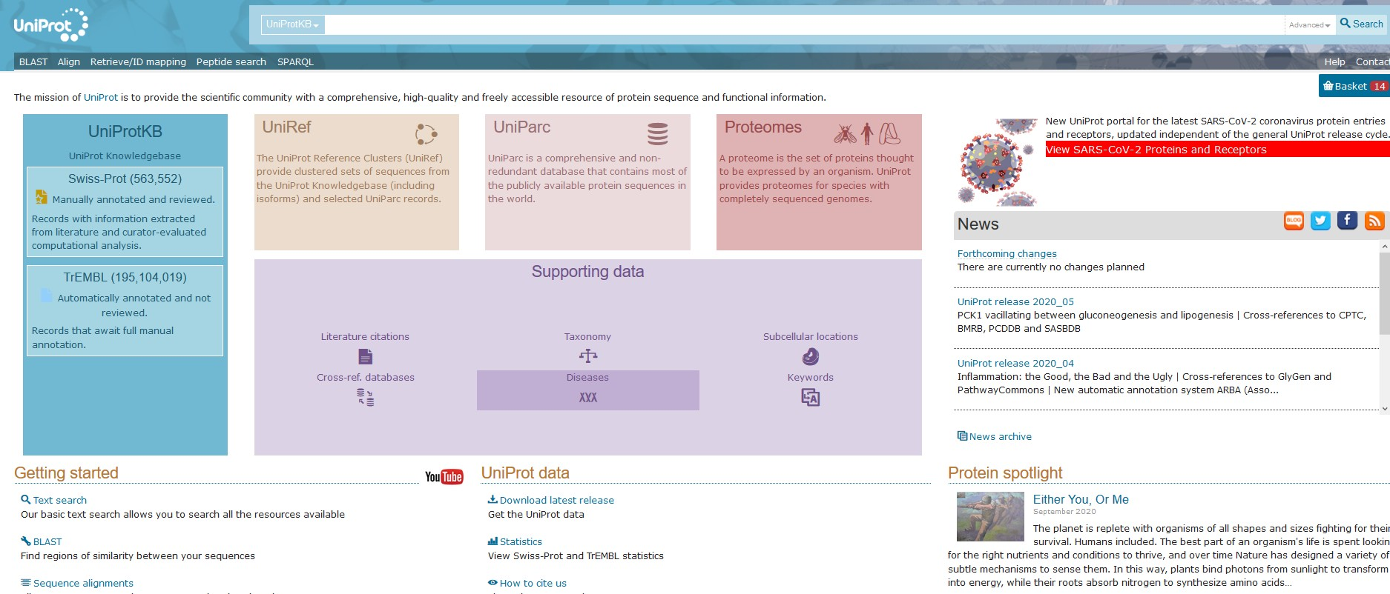
www.uniprot.org
Example 5: Using UniProt to access disease and mutagenesis data
Search for specific diseases using the diseases tab on the homepage

Slide 38
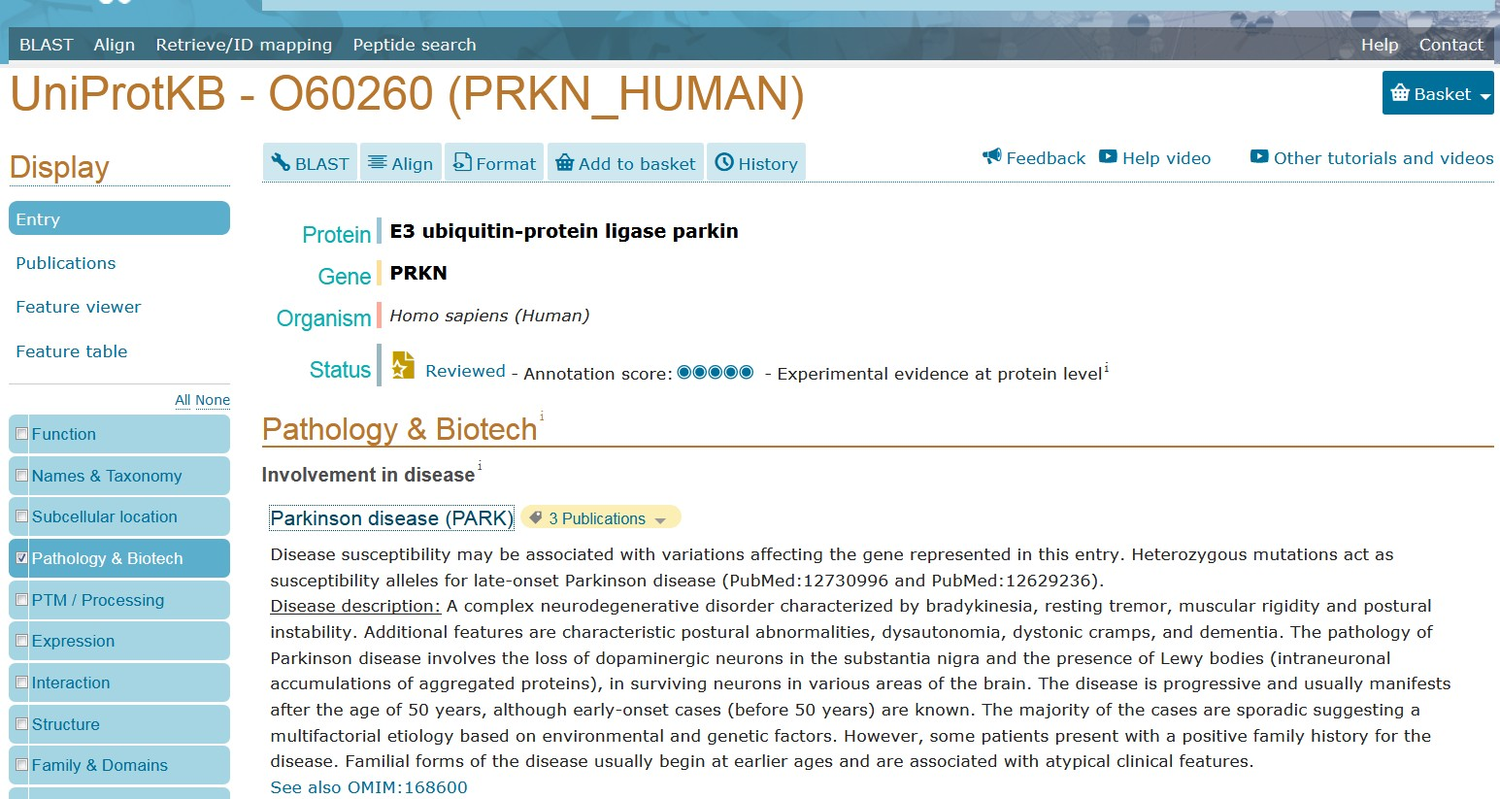
www.uniprot.org
Human disease data can be
accessed in human entries

Slide 39
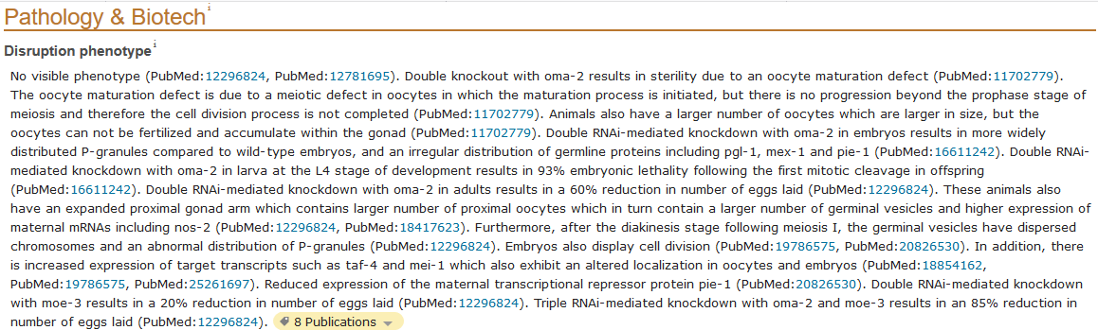
www.uniprot.org
Disruption phenotype sections in model organism entries describe phenotypes in null mutants and phenotypes that arise as a result of RNAi or morpholino knockdown
Phenotypes as a result of single/double/multiple mutations
Phenotypes as a result of RNAi or morpholino knockdown, indicating developmental stage if applicable

Slide 40
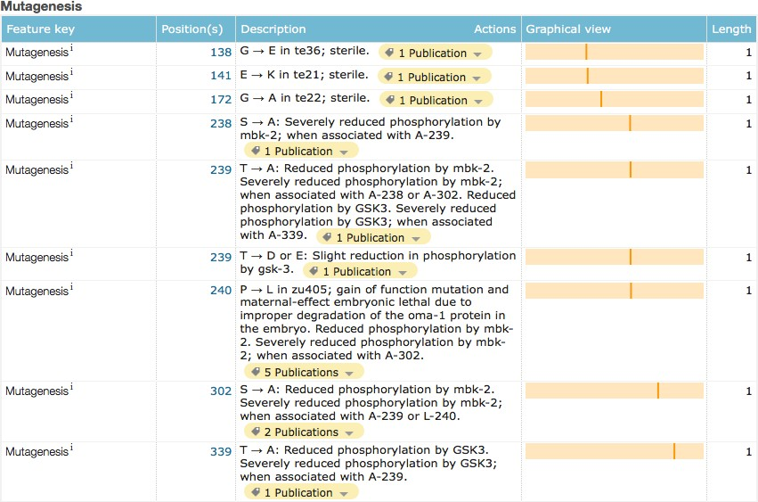
www.uniprot.org
Mutations that disrupt one or multiple amino acids are listed in the
feature table and feature viewer
Provide name of
mutant if known
Indicate if phenotype is due to mutations of several amino acids

Slide 41
Summary
Perform a search
Access functional data and sequences
Analyse sequences
Explore proteomes
Obtain disease and mutagenesis data
Also:
UniProt releases every 8 weeks and is freely available
Data is provided in a range of downloadable formats
text, XML, XML/RDF, FASTA, GFF, tab-delimited
Programmtic access using API

Slide 42
Class assignment
Find a human enzyme with no experimentally verified 3D structure in PDB.
Select a result that have a homologue in PDB
Identify possible protein function using Motif search

